Slide 1
Thesis
Emilio Benenati
Josyula Viswanath Das

Slide 2
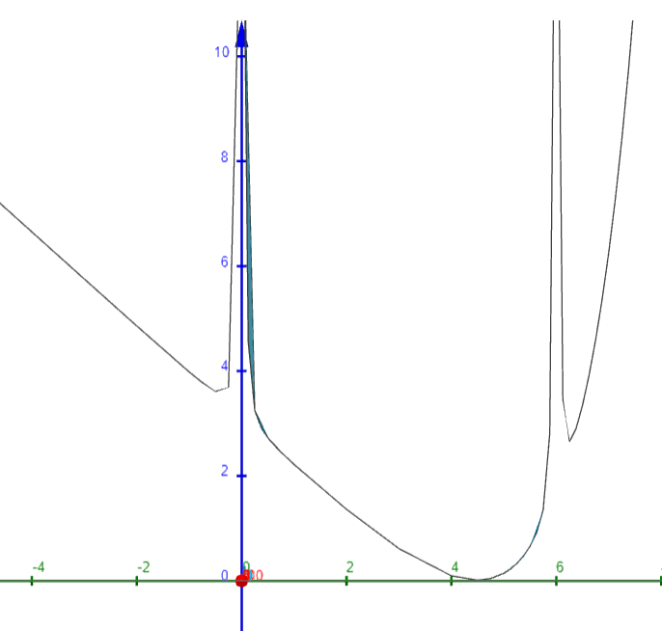
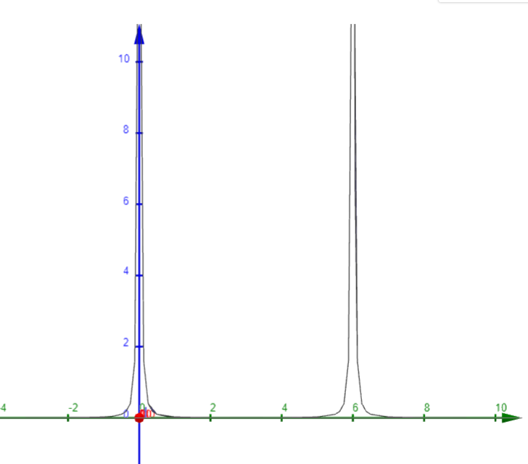
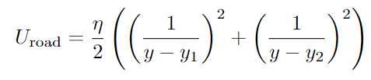

Car is travelling into the plane
HV
HV
(a) Old road potential
(b) New road potential

Slide 3
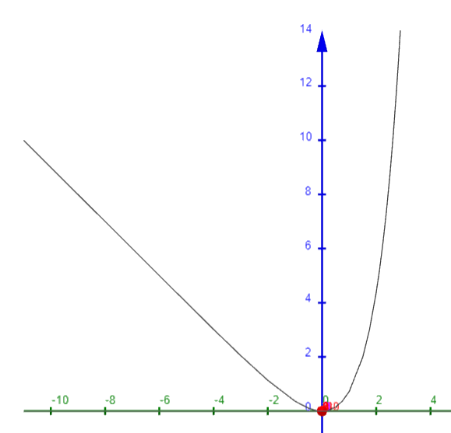


Slide 4
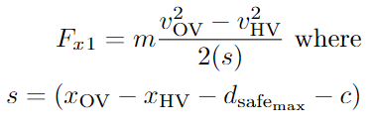

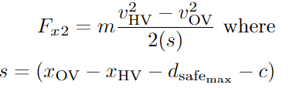

Velocity Control Using Constraints
This is done by limiting the range of accelerations depending on
If HV has to accelerate: This is done when the vehicle in front is faster than the HV and the limit of acceleration if given by
If HV has to accelerate: This is done when the vehicle in front is faster than the HV and the limit of acceleration if given by

Slide 5

The values of , , and are taken from the previous optimization step.
The question is that if this can be done and of the system is convex after using such a constraint.

Slide 6
New Formulation
Calculate the value of the optimal lane based on a number of different MLD constraints (longitudinal and lateral safety)
Based on the lane value, set up the road potential which will take the HV to the centre of the optimal lane.
Repeat.
The idea is to generate a recursive two-level optimization problem to generate first the optimal lane based on the reference, the obstacle vehicles as well as the safety constraints. Using the lane variable as a constant, design the new road APF and use it in the cost function.
Question 1: What is the difference between using the road APF to get it to the centre of the lane vs a lateral position reference to move the vehicle to the centre of the lane.

Slide 7
Question 2: Should I also use the first MPC problem to generate references for velocity as I think the velocity reference should be based on the distance that can be travelled safely between the obstacles in the same lane, the relative velocity between the HV and the obstacle in front of the HV as well as if there is a vehicle in the adjacent lane. This can help set a limit on the jerk (rate of change of acceleration) as we can design the profile.

